Slide 1
ENGR-304-L
Software Lab 02

Slide 2
Agenda
Attendance
Overview
Lab Materials
Getting Started

Slide 3
Overview
Recap:
Assembly code is assembled into machine code
Assembly code and machine code are closely related
This Lab:
Manually “assemble” a few lines of code to see the assembly process

Slide 4

Overview
NIOS Assembly has I, J, R Type Instructions
Each type has a specific bitfield format for interpreting 32-bit data
All types share the unique op-code field to identify which instruction
I Type
R Type

Slide 5

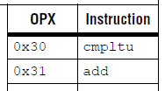
Overview
Example: “add r8, r9, r10”
R Type – opcode 0x3A, opx 0x31

Slide 6
Overview
Example: “add r8, r9, r10”
R Type – opcode 0x3A, opx 0x31

Slide 7
Overview
Example: “add r8, r9, r10”
R Type – opcode 0x3A, opx 0x31
0b ? ? ? ? ? ? ? ? ? ? ? ? ? ? ? 0 0 0 0 0 1 1 0 0 0 1 1 1 1 0 1 0

Slide 8

Overview
Example: “add r8, r9, r10”
R Type – opcode 0x3A, opx 0x31
0b ? ? ? ? ? ? ? ? ? ? ? ? ? ? ? 0 0 0 0 0 1 1 0 0 0 1 1 1 1 0 1 0

Slide 9
Overview
Example: “add r8, r9, r10”
R Type – opcode 0x3A, opx 0x31
0b 0 1 0 0 1 0 1 0 1 0 0 1 0 0 0 0 0 0 0 0 1 1 0 0 0 1 1 1 1 0 1 0

Slide 10
Overview
Example: “add r8, r9, r10”
R Type – opcode 0x3A, opx 0x31
0b 0 1 0 0 1 0 1 0 1 0 0 1 0 0 0 0 0 0 0 0 1 1 0 0 0 1 1 1 1 0 1 0
0x 4A90 0C7A

Slide 11
Overview
Memory Address Space
Program instructions and data are stored in memory
Memory is a larger and slower-to-access place to store data than registers

Slide 12
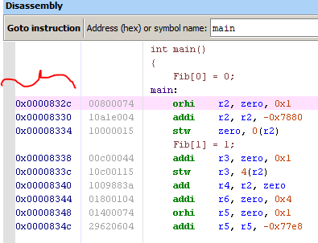
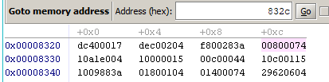
Overview
Memory Address Space
We can view & change instruction machine code in memory
We can view & change data in memory

Slide 13
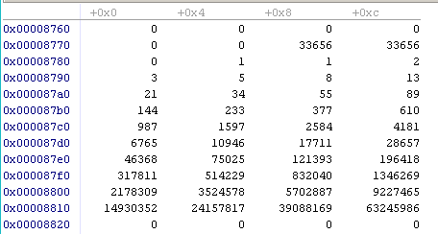
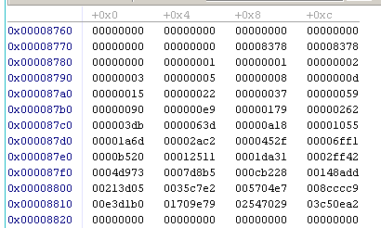
Overview
Memory Address Space
We can view & change instruction machine code in memory
We can view & change data in memory

Slide 14
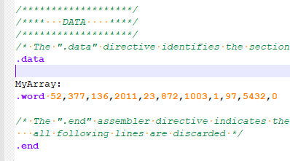
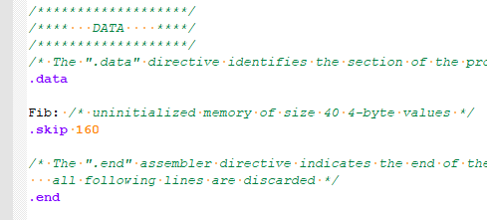
Overview
Assembly Usage of Memory
Declare data with initial values
Declare uninitialized data

Slide 15
Overview
Assembly Usage of Memory
Use stw to store a word (32bits) into memory at an address from a register
Use ldw to load a word from memory to a register
The gp register is intended to hold memory addresses, the ldw and stw instructions require the address to be in a register
Note immediate value offsets are also available in ldw/stw, may be 0

Slide 16
Overview
Optimization Considerations
Factors: code footprint (instructions in program) vs
code performance (instructions executed)
Compilers can optimize code to run faster with a smaller footprint, often useful but sometimes risky
For programs that are highly resource constrained, a careful & experienced assembly programmer can “beat” the compiler

Slide 17
Lab Materials
NIOS CPU Summary
NIOS CPU Reference
Notepad++ & Assembly Profile
Altera DE2 Boards & NIOS CPU Image
Quartus
Altera Debug Monitor

Slide 18
Getting Started
Setup project directory for SW02 on the H: drive
Download SW02 files from Moodle or S: drive
Also locate the reference files from SW01
Start following directions in the lab assignment document

Slide 19
Reference Diagrams
The remaining slides explain certain file types and compilation processes that will apply throughout the semester

Slide 20
Altera DE2 Board
Windows 10 PC
Quartus
FGPA
Peripheral Devices
(Ex: switches, buttons, hex displays)
NIOS Processor Image
NIOS Processor Image
(Flashed)
Switches
Keys
Software (Executing)
Altera DM
LEDs
NIOS Processor Image
7Seg Displays
Timer
Software (Loading/Debugging)

Slide 21
C Code
“portable” C-Code
Compiling
Assembly Code
Compiler-Generated for NIOS: view in debugger, depends on optimization
Assembling
Machine Code
Compiler-Generated for NIOS: view in memory, determine from reference
Loading
NIOS Processor Image
Loading
A system configuration for this FPGA component has been generated, it executes our program and can be viewed by the debugger
Flashed
We are using these in Engr304 Lab
NIOS Processor Hardware
Altera DE2 FPGA Hardware
We don’t have these in Engr304 Lab

Slide 22
C Code is fairly platform-agnostic and can be run on a variety of difference processors, each with their own assembly instruction sets. C Code is compiled into assembly code which is beneficial because the combination of C Code and a compiler has better maintainability, portability, readability, and shorter development times than raw assembly code.
C Code
Compiling
Assembly code is fairly platform-specific and may be shared by families of processors. Assembly code is almost at the level of machine code, but is more readable and maintainable than raw 0’s and 1’s. It is assembled into machine code.
Assembly Code
Assembling
Machine code is the raw 0’s and 1’s that can be interpreted by the processor in order to execute programs. It is rarely used or modified directly since changes to source code occur at the C Code or Assembly Code levels instead. However, it may be captured as an artifact of the build process for a particular program.
Machine Code
Loading
NIOS Processor Image
Loading
Machine code can be loaded onto an image of the processor for which it was assembled and executed therein. In this case, the processor image is the same as a physical processor (for the most part).
Flashed
An FPGA is like “general purpose hardware” which can be flashed with an image of a certain circuit. In this case, the FPGA is flashed with the NIOS Processor Image which allows it to perform essentially like a dedicated NIOS Processor hardware device.
NIOS Processor Hardware
Altera DE2 FPGA Hardware
Machine code can be loaded onto the processor for which it was assembled and “physically” executed therein.

Slide 23
C Code
Compiling
Assembly Code
Assembling
Machine Code
In Lab, the QSys setup helps configure and define what the NIOS Processor Image is.
Loading
NIOS Processor Image
Loading
Machine code can be loaded onto an image of the processor for which it was assembled and executed therein. In this case, the processor image is the same as a physical processor (for the most part).
Flashed
An FPGA is like “general purpose hardware” which can be flashed with an image of a certain circuit. In this case, the FPGA is flashed with the NIOS Processor Image which allows it to perform essentially like a dedicated NIOS Processor hardware device.
NIOS Processor Hardware
Altera DE2 FPGA Hardware

Slide 24
C Code
Compiling
Assembly Code
Assembling
Machine Code
Loading
NIOS Processor Image
Loading
Machine code can be loaded onto an image of the processor for which it was assembled and executed therein. In this case, the processor image is the same as a physical processor (for the most part).
In Lab, the Altera DE2 boards are FPGA’s (+ some peripherals) that we load the image onto.
Flashed
An FPGA is like “general purpose hardware” which can be flashed with an image of a certain circuit. In this case, the FPGA is flashed with the NIOS Processor Image which allows it to perform essentially like a dedicated NIOS Processor hardware device.
NIOS Processor Hardware
Altera DE2 FPGA Hardware

Slide 25
C Code
Compiling
Assembly Code
Assembling
Machine Code
Loading
NIOS Processor Image
Loading
In Lab, part of flashing the FPGA involves compiling a .sof file from a .bdf file. The .bdf holds the NIOS component from QSys and the .sof is specific to the DE2.
Machine code can be loaded onto an image of the processor for which it was assembled and executed therein. In this case, the processor image is the same as a physical processor (for the most part).
Flashed
An FPGA is like “general purpose hardware” which can be flashed with an image of a certain circuit. In this case, the FPGA is flashed with the NIOS Processor Image which allows it to perform essentially like a dedicated NIOS Processor hardware device.
NIOS Processor Hardware
Altera DE2 FPGA Hardware

Slide 26
C Code
In Lab, we write assembly code for the NIOS processor ( the .s file).
Compiling
Assembly code is fairly platform-specific and may be shared by families of processors. Assembly code is almost at the level of machine code, but is more readable and maintainable than raw 0’s and 1’s. It is assembled into machine code.
Assembly Code
Assembling
Machine code is the raw 0’s and 1’s that can be interpreted by the processor in order to execute programs. It is rarely used or modified directly since changes to source code occur at the C Code or Assembly Code levels instead. However, it may be captured as an artifact of the build process for a particular program.
Machine Code
Loading
NIOS Processor Image
Loading
Flashed
Altera DE2 FPGA Hardware
NIOS Processor Hardware

Slide 27
C Code
Compiling
Assembly code is fairly platform-specific and may be shared by families of processors. Assembly code is almost at the level of machine code, but is more readable and maintainable than raw 0’s and 1’s. It is assembled into machine code.
Assembly Code
In Lab, we can use the debug monitor to look into memory and see the machine code assembled based on the assembly code.
Assembling
Machine code is the raw 0’s and 1’s that can be interpreted by the processor in order to execute programs. It is rarely used or modified directly since changes to source code occur at the C Code or Assembly Code levels instead. However, it may be captured as an artifact of the build process for a particular program.
Machine Code
Loading
NIOS Processor Image
Loading
Flashed
Altera DE2 FPGA Hardware
NIOS Processor Hardware

Slide 28
